Slide 1

GYM MANAGEMENT SYSTEM
SRM INSTITUTE OF SCIENCE AND TECHNOLOGY
FACULTY OF ENGINEERING AND TECHNOLOGY
DEPARTMENT OF NETWORKING AND COMMUNICATIONS
21CSC202J – ADVANCED PROGRAMMING PRACTICE
SARANSH SINGH (RA2212703010013)
HEMAGIRISAI BHUPATI (RA2212703010016)
SECTION : T2
Guide name and Designation: Dr. K A Varun Kumar Associate Professor
Department of Networking and Communications

Slide 2
Table of contents
Introduction
Abstraction
Graphical User Interface
Database Design
Implementation
Output
Literature Survey
References

Slide 3

INTRODUCTION
Managing a gym is a dynamic and multifaceted endeavor that involves the coordination of various elements to create a successful fitness facility. Gym management encompasses a range of responsibilities, from ensuring the safety and satisfaction of members to optimizing operational efficiency and profitability. In this introduction, we'll explore the key components of gym management and the essential considerations for running a thriving fitness center.

Slide 4
ABSTRACT
The Gym Management System (GMS) is a comprehensive software solution designed to streamline and enhance the operations of fitness centers, gyms, and health clubs. In an increasingly health-conscious society, the demand for efficient and user-friendly gym management systems has grown significantly. This abstract provides an overview of the key features and benefits of the Gym Management System, which aims to optimize the management of fitness facilities, improve member experiences, and drive business growth.

Slide 5
ABSTRACT
. 1. Membership Management:
Registration and member profiles.
Payment processing and billing.
Membership renewal and cancellations
.
2. Class and Schedule Management:
Class scheduling and booking.
Instructor and trainer assignments.
Real-time availability updates.
Key Features:

Slide 6
ABSTRACT
4. Financial Management:
Revenue tracking and reporting.
Expense management and budgeting.
Invoicing and payment tracking.
5. Member Engagement:
Communication tools for member announcements.
Integration with fitness apps and wearables.
Member feedback and satisfaction surveys.

Slide 7
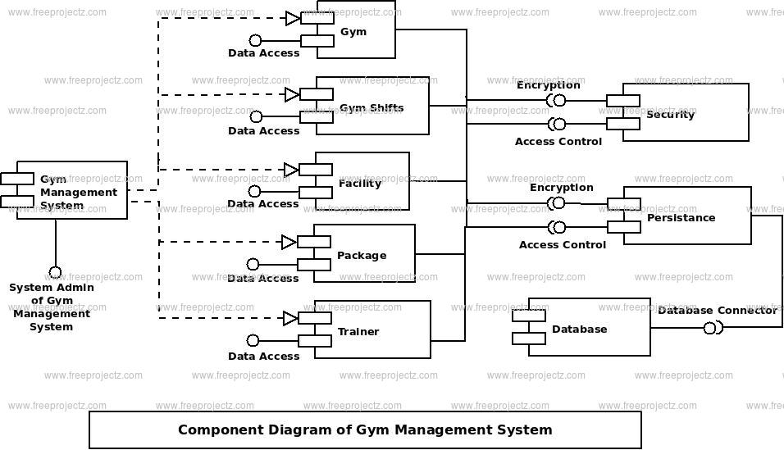
.

Slide 8
GRAPHICAL USER INRERFACE
In this project we have used Swing library in Java which is a Graphical User Interface (GUI) toolkit that includes the GUI components. Swing provides a rich set of widgets and packages to make sophisticated GUI components for Java applications. Swing is a part of Java Foundation Classes(JFC), which is an API for Java GUI programing that provide GUI.

Slide 9
GRAPHICAL USER INRERFACE
GUI in Java is an easy-to-use visual experience builder for Java applications. It is mainly made of graphical components like buttons, labels, windows, etc. through which the user can interact with an application. GUI plays an important role to build easy interfaces for Java applications.

Slide 10
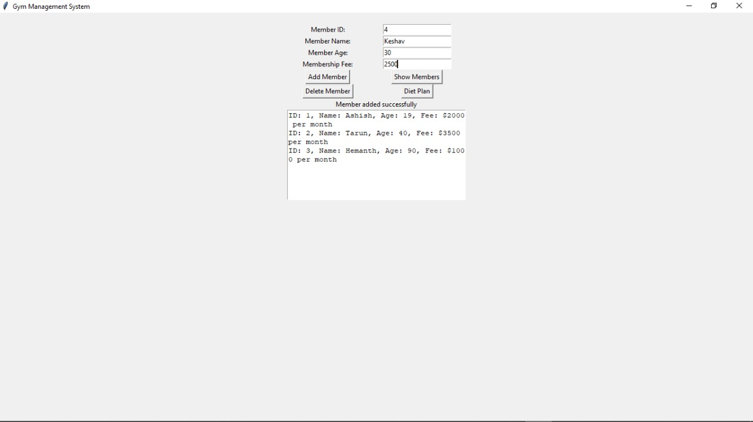
GUI OUTPUT

Slide 11
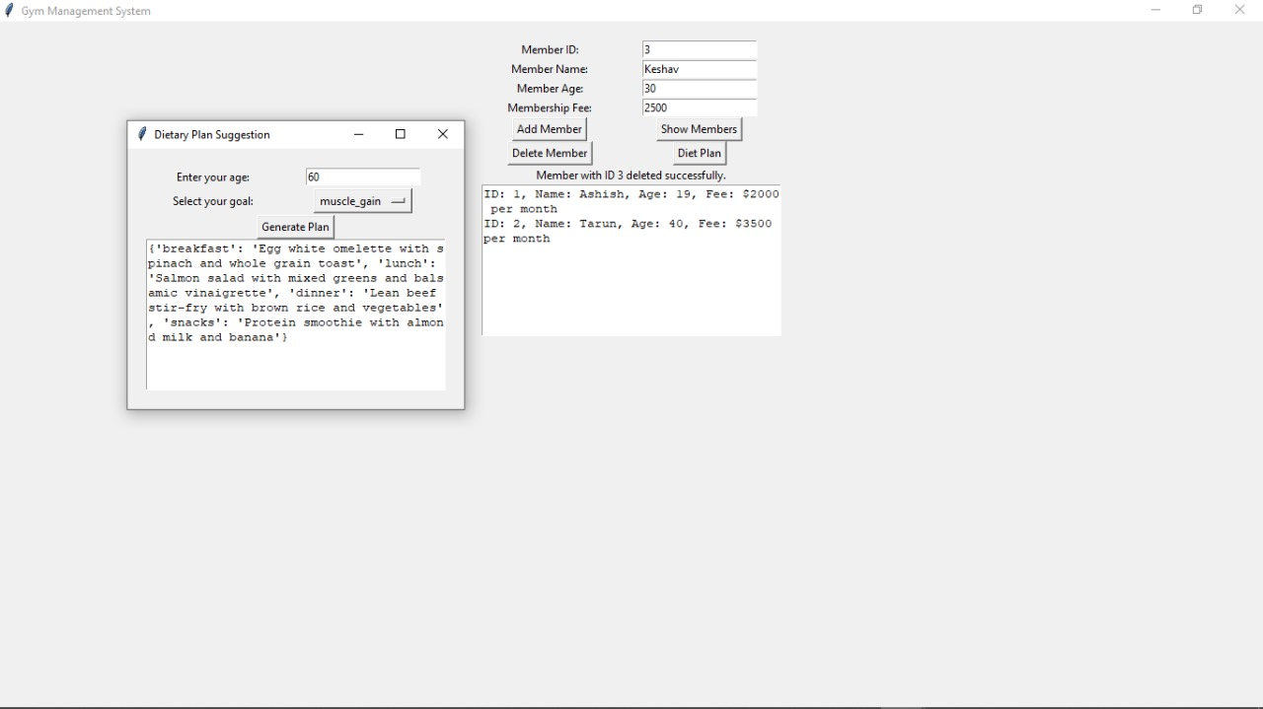
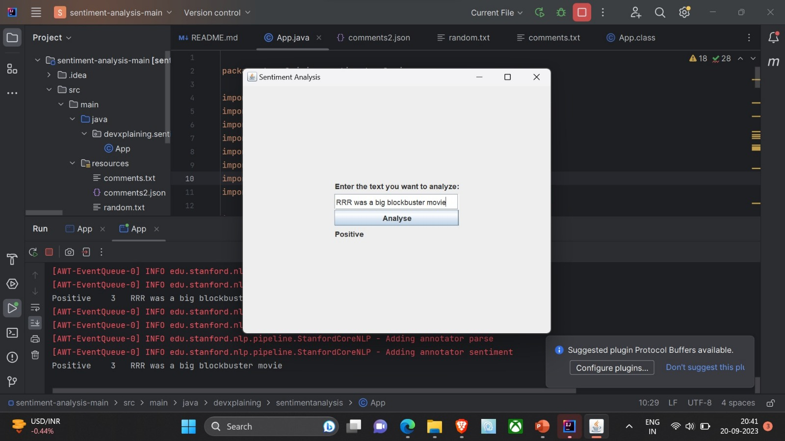
GUI OUTPUT

Slide 12
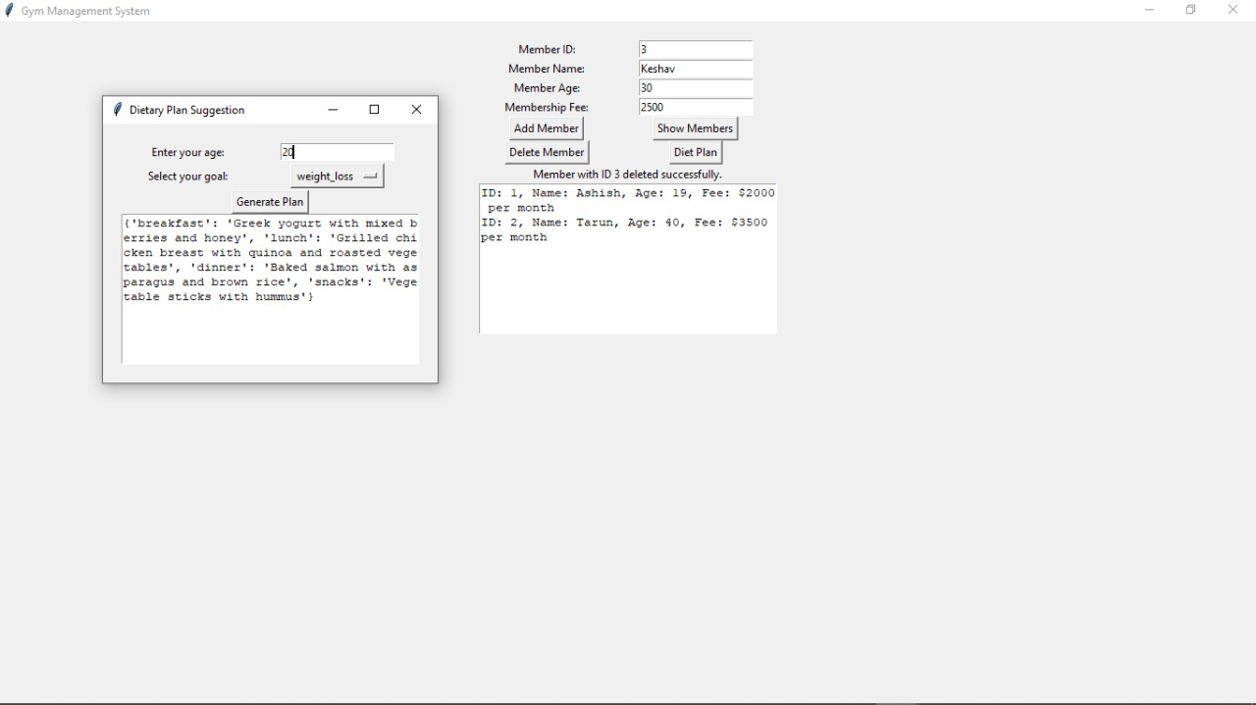
GUI OUTPUT

Slide 13
DATABASE DESIGN
A JSON document database is a type of nonrelational database that is designed to store and query data as JSON documents, rather than normalizing data across multiple tables, each with a unique and fixed structure, as in a relational database.

Slide 14
DATABASE DESIGN
JSON document databases use the same document-model format that developers use in their application code, which make it much easier for them to store and query data.

Slide 15
DATABASE DESIGN
The flexible, semi-structured, and hierarchical nature of JSON document databases allows them to evolve with applications’ needs. JSON document databases provide powerful and intuitive APIs for flexible and agile development.

Slide 16
IMPLEMENTATION
import tkinter as tkimport
jsonclass GymManagementSystem:
def _init_(self, root):
self.root = root
self.root.title("Gym Management System")
self.main_frame = tk.Frame(root)
self.main_frame.pack(padx=20, pady=20)
self.member_id_label = tk.Label(self.main_frame, text="Member ID:") self.member_id_label.grid(row=0, column=0)
self.member_id_entry = tk.Entry(self.main_frame)
self.member_id_entry.grid(row=0, column=1)
self.member_name_label = tk.Label(self.main_frame, text="Member Name:") self.member_name_label.grid(row=1, column=0) self.member_name_entry = tk.Entry(self.main_frame)
self.member_name_entry.grid(row=1, column=1)
self.member_age_label = tk.Label(self.main_frame, text="Member Age:") self.member_age_label.grid(row=2, column=0)
self.member_age_entry = tk.Entry(self.main_frame)
self.member_age_entry.grid(row=2, column=1)

Slide 17
IMPLEMENTATION
self.membership_fee_label = tk.Label(self.main_frame, text="Membership Fee:") self.membership_fee_label.grid(row=3, column=0) self.membership_fee_entry = tk.Entry(self.main_frame) self.membership_fee_entry.grid(row=3, column=1) self.add_member_button = tk.Button(self.main_frame, text="Add Member", command=self.add_member) self.add_member_button.grid(row=4, column=0) self.show_members_button = tk.Button(self.main_frame, text="Show Members", command=self.show_members) self.show_members_button.grid(row=4, column=1)

Slide 18
IMPLEMENTATION
self.delete_member_button = tk.Button(self.main_frame, text="Delete Member", command=self.delete_member) self.delete_member_button.grid(row=5, column=0) self.diet_plan_button = tk.Button(self.main_frame, text="Diet Plan", command=self.open_diet_plan_window) self.diet_plan_button.grid(row=5, column=1) self.status_label = tk.Label(self.main_frame, text="") self.status_label.grid(row=6, column=0, columnspan=2) self.member_list_text = tk.Text(self.main_frame, height=10, width=40) self.member_list_text.grid(row=7, column=0, columnspan=2) def save_data_to_json(self): with open("gymdata.json", "w") as json_file: json.dump(self.members_data, json_file)

Slide 19
IMPLEMENTATION
def add_member(self):
member_id = self.member_id_entry.get()
member_name = self.member_name_entry.get()
member_age = self.member_age_entry.get()
membership_fee = self.membership_fee_entry.get()
if not all([member_id,
member_name
, member_age,
membership_fee]):
self.status_label.config(text="Please fill in all fields")
return
member = { "id": member_id, "name": member_name, "age": member_age,
"membership_fee": membership_fee }

Slide 20
IMPLEMENTATION
self.members_data.append(member)
self.save_data_to_json()
self.status_label.config(text="Member added successfully")
self.member_id_entry.delete(0, tk.END)
self.member_name_entry.delete(0, tk.END)
self.member_age_entry.delete(0, tk.END)
self.membership_fee_entry.delete(0, tk.END)
def show_members(self):
self.member_list_text.delete(1.0, tk.END)
for member in self.members_data:
self.member_list_text.insert(tk.END, f"ID:
{member['id']}, Name: {member['name']},
Age: {member['age’]},
Fee: ${member['membership_fee']} per month\n")
def open_diet_plan_window(self):
diet_plan_window = tk.Toplevel(self.root) app2 = DietaryPlanSuggestion(diet_plan_window)
def delete_member(self): member_id = self.member_id_entry.get()
if not member_id: self.status_label.config(text="Please enter a Member ID to delete.")
return

Slide 21
IMPLEMENTATION
deleted = False
for member in self.members_data:
if member['id'] == member_id:
self.members_data.remove(member)
self.save_data_to_json()
self.status_label.config(text=f"Member with ID {member_id} deleted successfully.")
deleted = True break if not deleted:
self.status_label.config(text=f"Member with ID {member_id} not found.")
class DietaryPlanSuggestion: def _init_(self, root):
self.root = root self.root.title("Dietary Plan Suggestion")
self.main_frame = tk.Frame(root)
self.main_frame.pack(padx=20, pady=20)
self.age_label = tk.Label(self.main_frame, text="Enter your age:")
self.age_label.grid(row=0, column=0)
self.age_entry = tk.Entry(self.main_frame)
self.age_entry.grid(row=0, column=1)

Slide 22
IMPLEMENTATION
self.goal_label = tk.Label
(self.main_frame, text="Select your goal:")
self.goal_label.grid(row=1, column=0)
self.goal_var = tk.StringVar()
self.goal_var.set("weight_loss")
self.goal_menu = tk.OptionMenu(self.main_frame, self.goal_var, "weight_loss", "muscle_gain")
self.goal_menu.grid(row=1, column=1)
self.generate_button = tk.Button(self.main_frame, text="Generate Plan",
command=self.generate_dietary_plan)
self.generate_button.grid(row=2, column=0, columnspan=2)
self.result_text = tk.Text(self.main_frame, height=10, width=40) self.result_text.grid(row=3, column=0, columnspan=2)
self.dietary_plans = { "weight_loss": { "1": {
"breakfast": "Greek yogurt with mixed berries and honey", "lunch": "Grilled chicken breast with quinoa and roasted vegetables", "dinner": "Baked salmon with asparagus and brown rice", "snacks": "Vegetable sticks with hummus" },

Slide 23
IMPLEMENTATION
"2": { "breakfast": "Avocado toast with poached eggs", "lunch": "Mixed greens salad with grilled shrimp and vinaigrette", "dinner": "Quinoa-stuffed bell peppers with lean ground turkey", "snacks": "Handful of almonds and an apple" },
"3": { "breakfast": "Chia seed pudding with fresh fruits", "lunch": "Grilled fish with quinoa and steamed vegetables", "dinner": "Baked chicken with wild rice and mixed greens", "snacks": "Yogurt with nuts and berries" },
"4": { "breakfast": "Oatmeal with sliced banana and nuts", "lunch": "Grilled chicken breast with steamed vegetables", "dinner": "Baked fish with quinoa and green salad", "snacks": "Greek yogurt with honey and walnuts"

Slide 24
IMPLEMENTATION
public static List<SentimentRecord> analyzeAndReturn(String content) {
var props = new Properties();
// tokenizer, sentence splitting, consistuency parsing, sentiment analysis
props.setProperty("annotators", "tokenize, ssplit, parse, sentiment");
var pipeline = new StanfordCoreNLP(props);
var annotation = pipeline.process(content);
return annotation.get(CoreAnnotations.SentencesAnnotation.class).stream()
.map(App::convertToSentimentRecord)
.filter(App::negativeComments)
//.filter(App::positiveComments)
.collect(Collectors.toList());
}
private static String loadResourceFromClasspath() throws IOException {
var inputStream = App.class.getClassLoader().getResourceAsStream("comments.txt");
return new String(inputStream.readAllBytes(), StandardCharsets.UTF_8);
}
private static String loadResourceFromClasspath2() throws IOException {
var inputStream = App.class.getClassLoader().getResourceAsStream("comments.json");
return new String(inputStream.readAllBytes(), StandardCharsets.UTF_8);
}
}

Slide 25
IMPLEMENTATION
def get_dietary_plan(self, age, goal): age_group = None
if age >= 18 and age <= 30:
age_group = "1"
elif age >= 31 and age <= 45:
age_group = "2"
elif age >= 46 and age <= 60:
age_group = "3" elif age > 60:
age_group = "4"
else: age_group = "0"
dietary_plan = self.dietary_plans.get(goal, {}).get(age_group, None)
return
dietary_planif _name_ == "_main_": root = tk.Tk() app = GymManagementSystem(root)
app.members_data = [] # Initialize members data root.mainloop()

Slide 26
OUTPUT
.

Slide 27
LITERATURE SURVEY
.
PAPER TITLE | AUTHOR | YEAR OF PUBLICATION | PUBLISHERS | ALGORITHMS/TOOLS/TECHNIQUE Used
GYM MANAGEMENT SYSTEM: A Survey | Pang, B., & Lee, L. | 2008 | Now Publishers Inc. | Provides an in-depth overview of gym suvery techniques, focusing on machine learning-based approaches and challenges , applications of sentiment analysis in various domains.
Deep Learning for GYM MANAGEMENT SYSTEMA Survey | Zhang, W., & Wang, D. | 2018 | Wiley Online Library | Reviews the application of neural networks in gym system tasks,provides insights into various deep learning architectures for sentiment analysis.
A Comprehensive Survey gym management system on Twitter Data | Go, A., Bhayani, R., & Huang, L. | 2009 | Proceedings of the Fourth International AAAI Conference on Weblogs and Social Media | Focusing on Twitter data, this survey paper provides an overview of gym system techniques specifically tailored for microblogging platforms. It discusses the unique characteristics and challenges of analyzing sentiment in short texts
Opinion Mining and gym management system : A Survey | Pang, B., Lee, L., & Vaithyanathan, S. | 2002 | Foundations and Trends® in Information Retrieval | A foundational survey that explores the early developments in gym management systemand opinion mining. It discusses the challenges and techniques for classifying opinions in text data.

Slide 28
REFERENCES
https://blogs.oracle.com/javamagazine/post/java-sentiment-analysis-stanford-corenlp
https://www.geeksforgeeks.org/machine-learning
https://ieeexplore.ieee.org/document/9498965
https://www.youtube.com/watch?v=a80s6CvvSfc&ab_channel=DevXplaining

